Slide 1

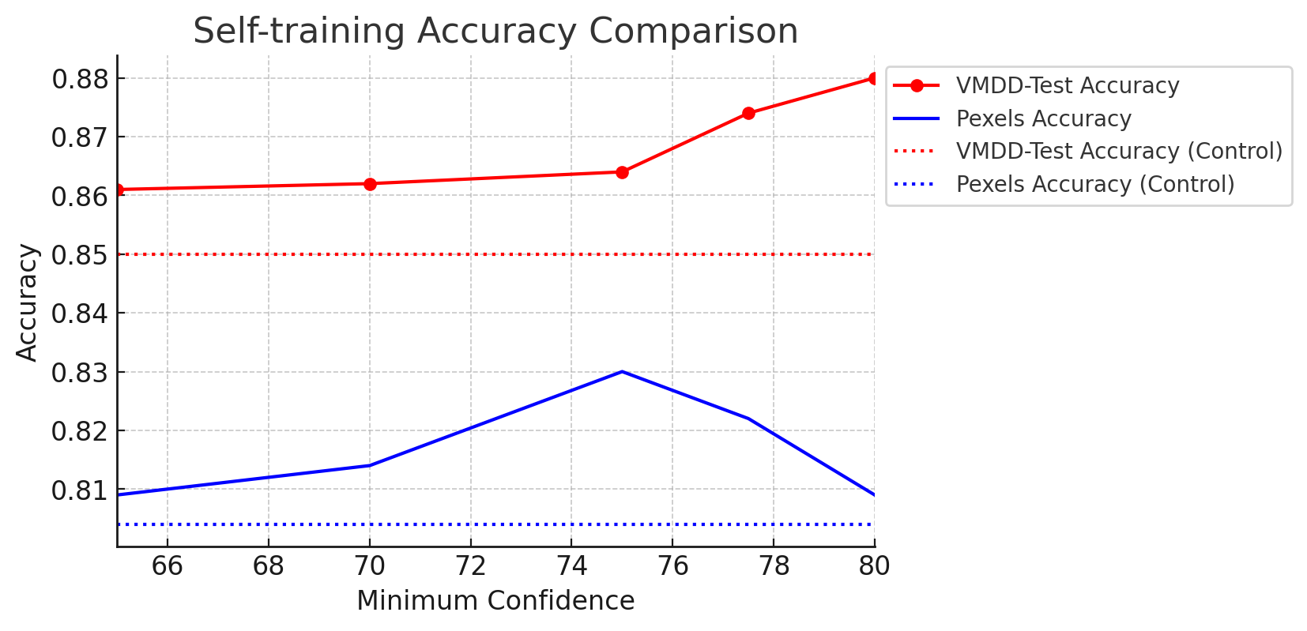
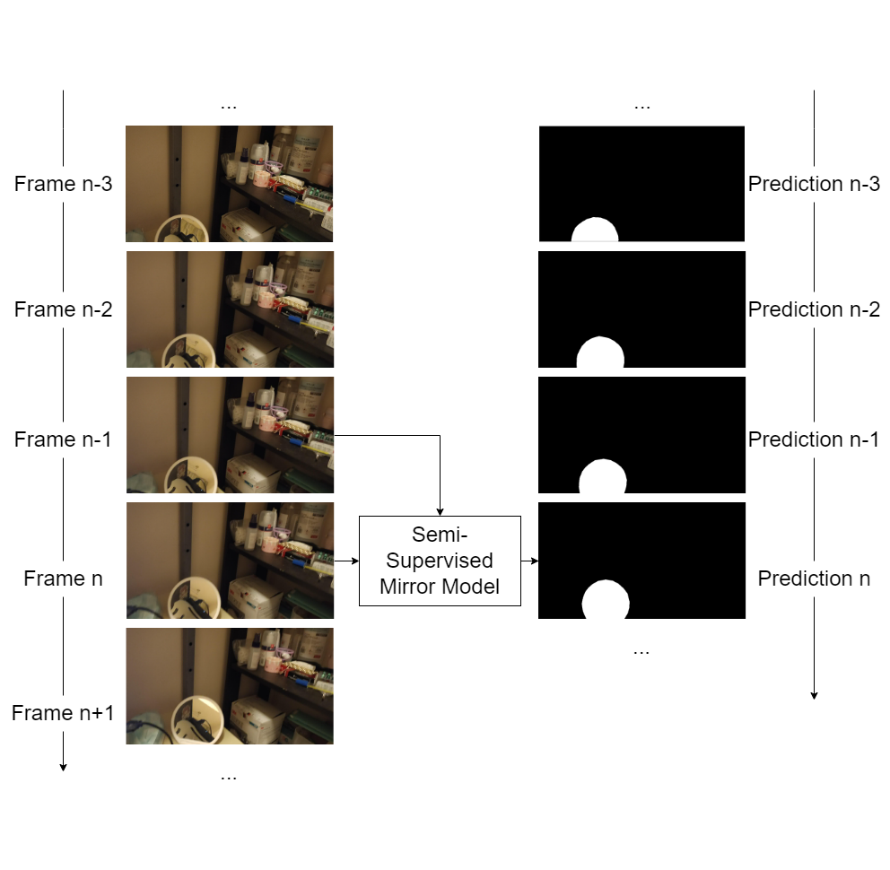
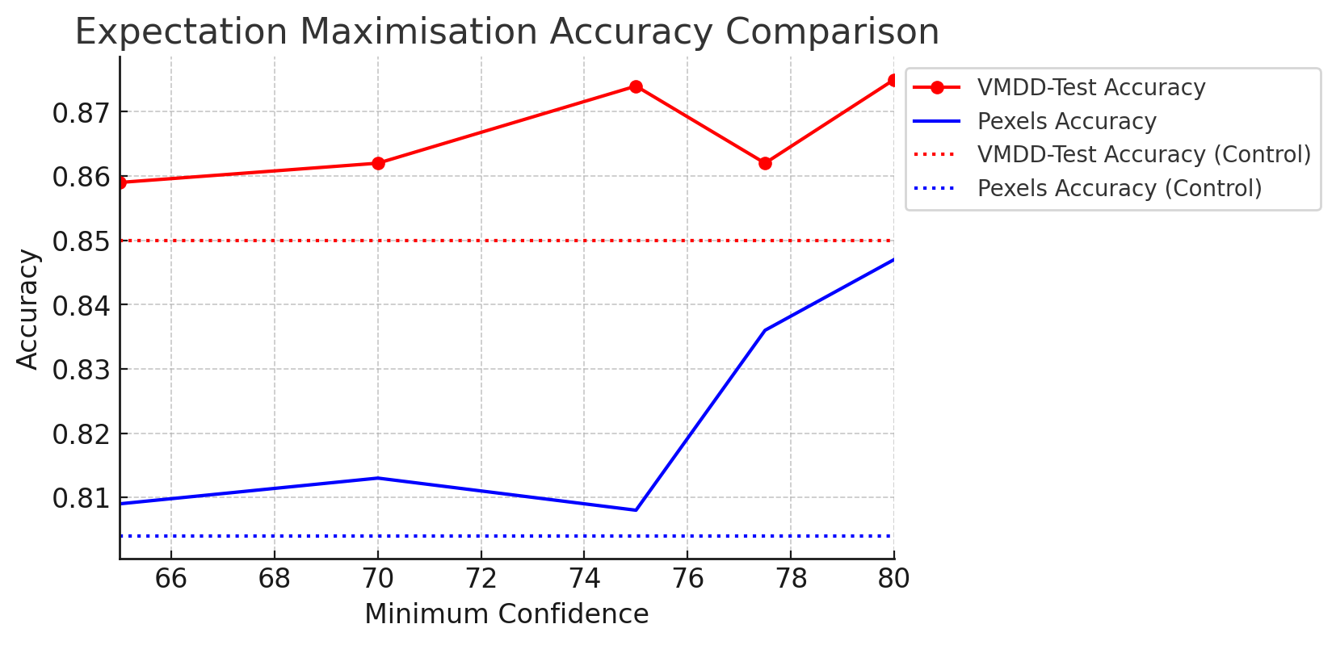
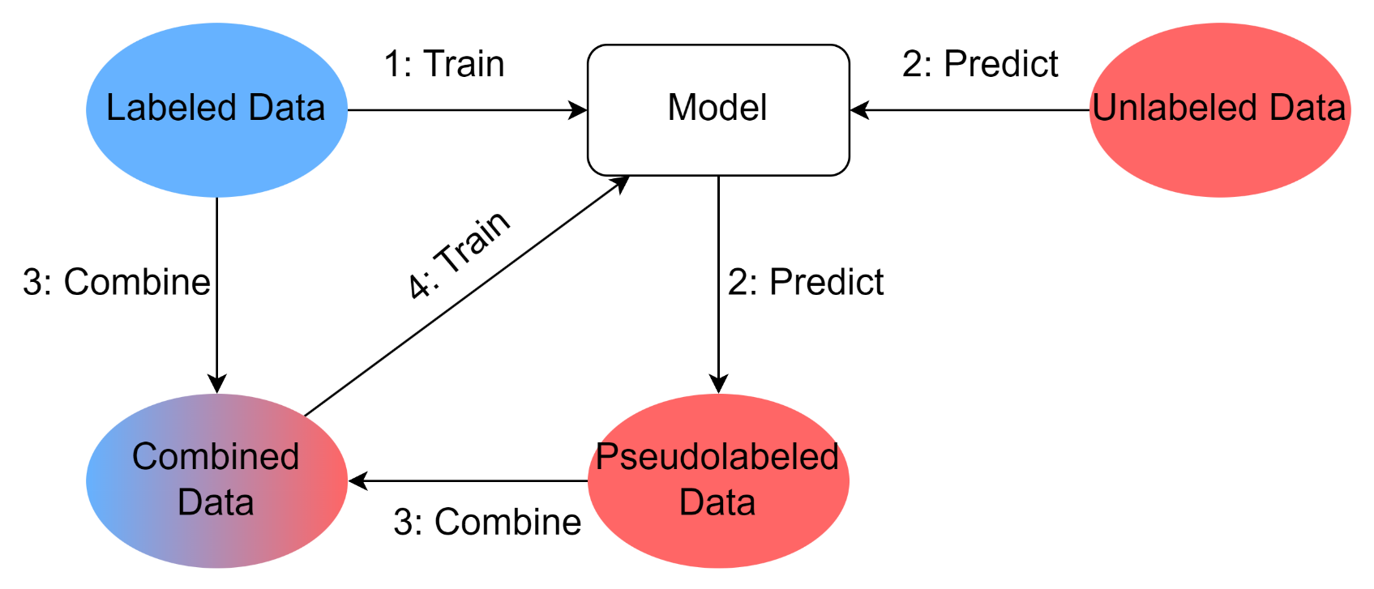
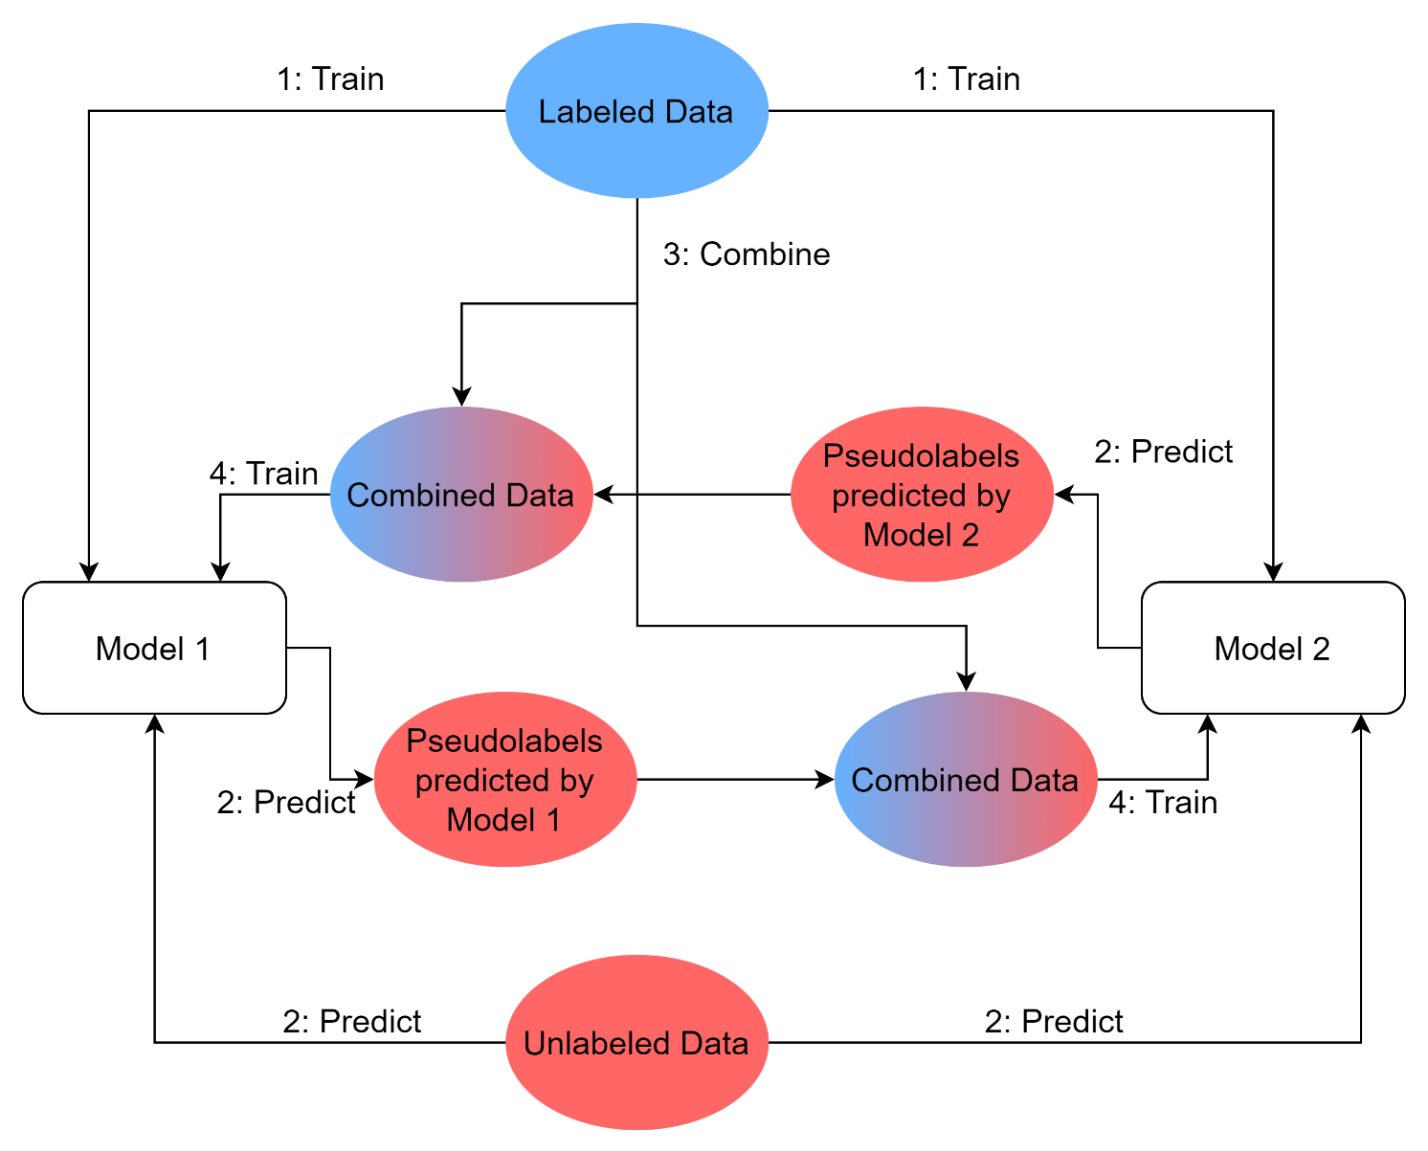
Semi-Supervised Approach to Mirror Detection in Videos
Iain High
4th Year Honours Project 2024
School of Informatics; University of Edinburgh
Abstract Existing mirror detection datasets have a high degree of similarity between the training and test set. This leads to the existing SOTA performing well on the test set, but substantially worse on dissimilar data. To address this issue, we introduce two new datasets which are much less similar. We also introduce three different models which use semi-supervised techniques during model training to enable better adaptability. We find each of our semi-supervised approaches outperforms current SOTA. |  |  |  | Dataset The existing Video Mirror Detection Dataset (VMDD) primarily features mirrors in consistent settings. This leads to high similarity between the training and test set – the model performs well on the test set but doesn’t adapt well to dissimilar data. To overcome this, we compiled a vast unlabelled mirror dataset of 228,541 video frames. Additionally, we created a smaller, annotated dataset to evaluate the model’s adaptability to varied environments.
Motivation Mirrors and reflective surfaces pervade our modern environment. Despite their significance, they remain absent from major object detection and segmentation datasets (ImageNet, CIFAR, COCO). This leads to mirrors significantly impacting CV tasks. Mirrors were identified to be one of the six primary sources of error in person detection. Majority of mirror detection work focuses on identifying mirrors in single images. |  | Contributions Collecting two new mirror datasets – a large unannotated dataset used for semi-supervised training, and a small annotated dataset used to measure adaptability of the model. Implementing self-training, expectation-maximisation, and co-training techniques Testing each of these semi-supervised approaches on both the existing dataset and newly created annotated dataset. |  |  |  | Evaluation As can be seen from the results above, introducing more diverse data through semi-supervised approaches significantly increases the model’s ability to adapt to dissimilar videos. On top of this, the semi-supervised approaches perform better than the SOTA on the original test set. This is the first time semi-supervised techniques have been attempted on the mirror detection problem. Future work in the domain of mirror detection could focus on detection of concave and convex mirrors.
Left: Self-training and EM
Below: Co-training

